Slide 1





Smart Click
Multi-Location Wireless Light Switch

Slide 2




Team member
Name : Kim Sihyo
Student ID : 16309003
Name : Shin Kiho
Student ID : 15309003
Name : Park Jisu
Student ID : 15309004
Name : Roxane Mailharro
Student ID : 16920014

Slide 3
introduction

Slide 4
Objectives
1. Popularized home automation/ Smart home concept.
2. Create room integration with simple steps.
3. Provide affordable product in the market.
4. Accessible, stable, and secure smart phone.

Slide 5
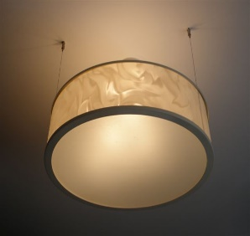
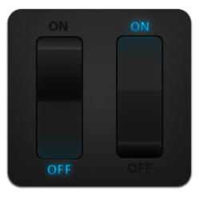
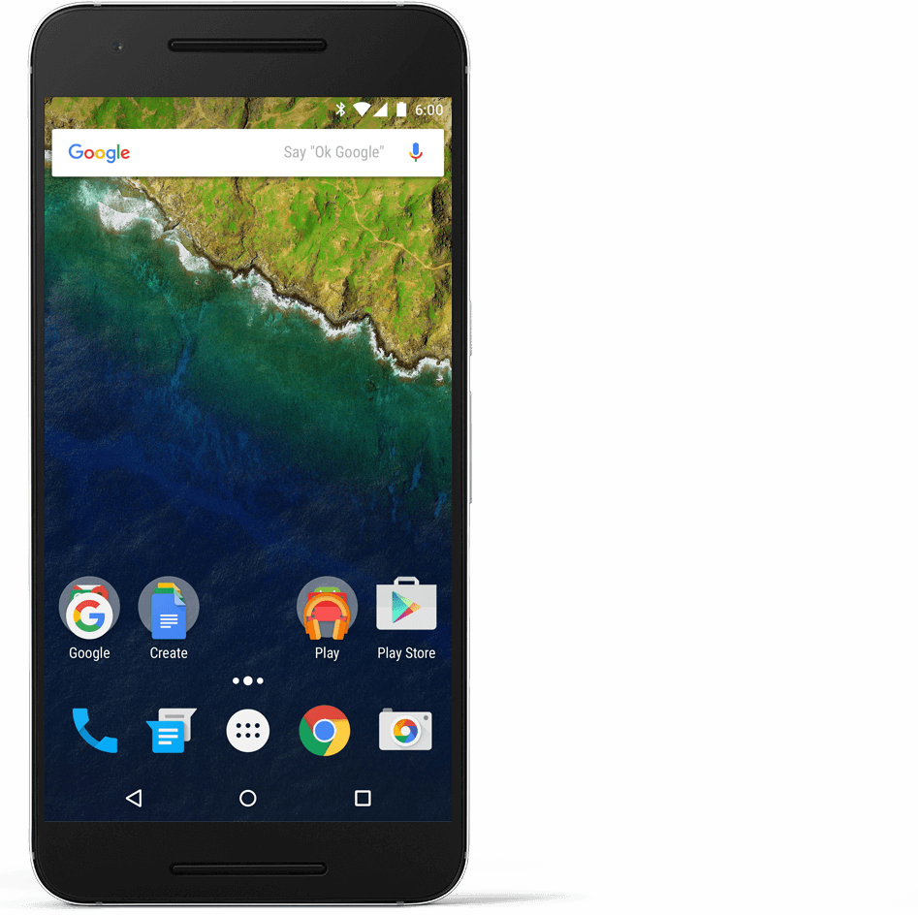
Our project
The product service consists of 3 parts:
Switch ability, turning the switch into the desirable position using wireless element. User does not have the need for physical contact with the switch.
Scheduling time, setting up alarm and configure the live-time for the light. We consider this feature to be beneficial for user that can not sleep without light but also want to save electricity.
Dashboard, on this feature user can list switch that is controlled using the application and see the status of it.

Slide 6
Areas of impact
Middle Class Family
Restaurant
KTV
Hotel
Inn

Slide 7
Project Report

Slide 8
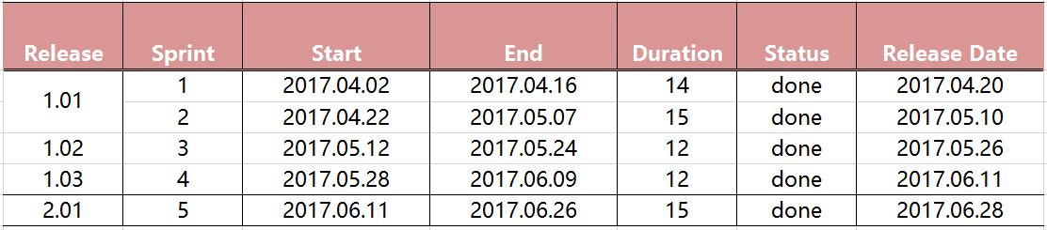
Release Plan

Slide 9
Product backlog
Priority
ID | User Story | Estimation | Priority
2 | As a Product Owner I want the switch device to receives signal and turn on/off the light | 2 weeks | 1
1 | As an User I want my application to control the light switch | 2 weeks | 2
4 | As an User I want my application to automatically connect to Bluetooth | 2 weeks | 3
5 | As an User I want to schedule light live-time | 2 weeks | 4
3 | As an User I want swipe the control button on my application | 2 weeks | 5
High
Low

Slide 10
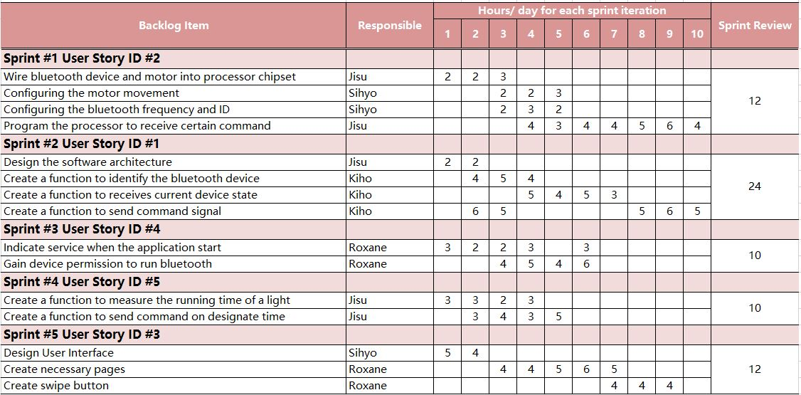
Sprint Backlog
As an User I want swipe the control button on my application
As an User I want my application to control the light switch
As an User I want my application to automatically connect to Bluetooth
As an User I want to schedule light live-time
As an User I want swipe the control button on my application

Slide 11
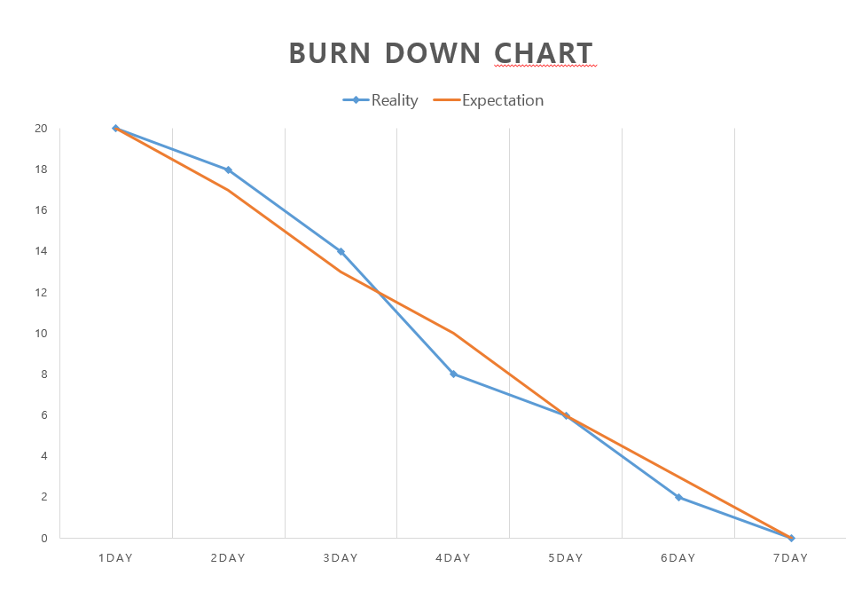
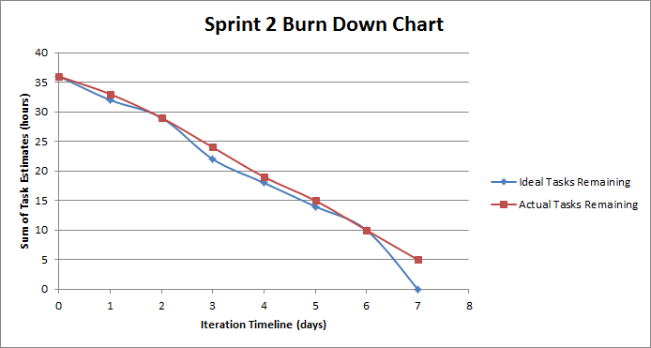
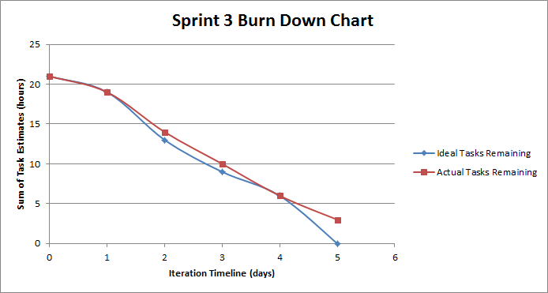
Sprint burn down

Slide 12
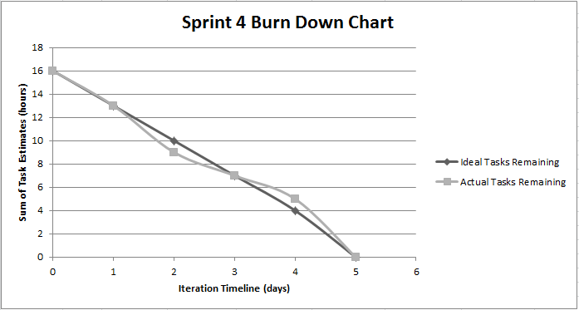
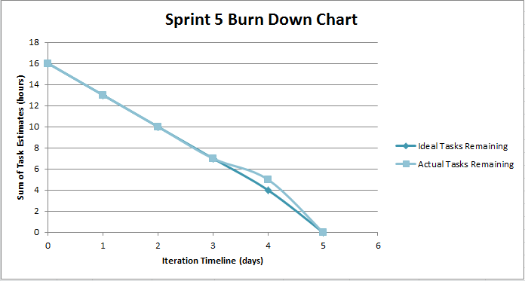
Sprint burn down

Slide 13
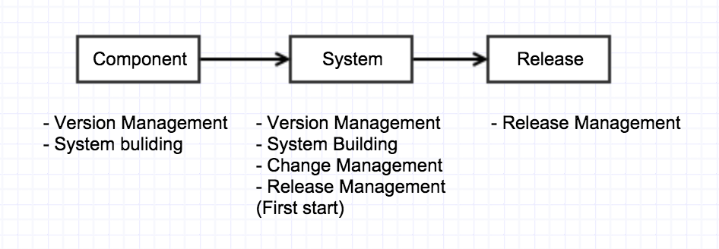
Configuration management
Configuration Management Process
Notes:
Version Management :
When independent development management not overlap each other.
Change Management :
Tracking the changing requirements Management

Slide 14
Configuration Item
 | Configuration Item | Note
1 | Project plan | Planning
2 | Configuration Management document | Planning
3 | Changing Management document | Planning
4 | Requirements definition document | Planning
5 | Design definition document | Design
6 | Source Code definition document | Development
7 | Design guide | Design
8 | Coding guide | Development
9 | Testing document | Planning /Development
10 | User manual | Planning
Notes:
We conducted five Planning part, 2 of Design part, 3 Development of the project and consists of a total of 10 Software Configuration item. This plan was carried out systematically by 10 Software Configuration item Configuration.

Slide 15
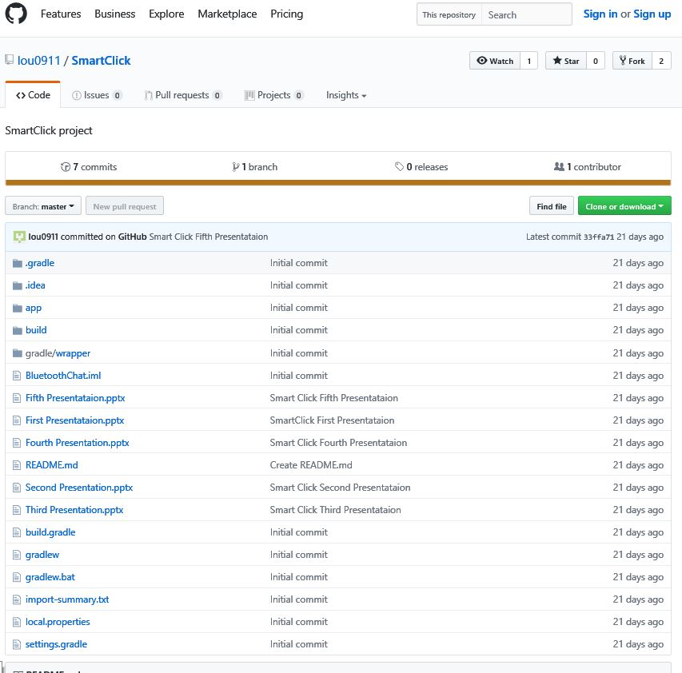
github
Github address:
https://github.com/lou0911/SmartClick
Notes:
We conducted five Planning part, 2 of Design part, 3 Development of the project and consists of a total of 10 Software Configuration item. This plan was carried out systematically by 10 Software Configuration item Configuration.

Slide 16
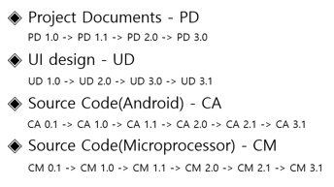
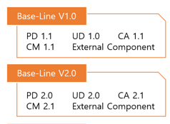
Configuration Management
Software Configuration Item (SCI)
Version | Comments
PD 1.0 ,UD 1.0,CA 1.0CM 1.0 | First Draft
PD 1.1 UD 1.1 | Introduction section completed.
CA 1.1,CM 1.1 | The first configuration source code.
BaseLine1 | Base-Line 1 completed (PD 1.1, UD 1.1, CA 1.1, CM 1.1)
PD 2.0 ,UD 2.0 | User Interface Design Configuration
CA 2.0 , CM 2.0 | Microprocessor, Android Source code
CA 2.1 , CM 2.1 | Configuration Bluetooth Source code
BaseLine2 | Base-Line2 completed (PD 2.0, UD 2.0, CA 2.1 CM 2.1)
Notes:
We have developed in four parts. Project Document , UI design, Source Code(Android) , Source Code(Microprocessor)
This one is our configuration management result.
A version of document begins with 0.1 and it is increased by 0.1.
When Base-Line is registered, give 1.0 version and it is increased by 0.1.
Like this we got the two Base-Line.

Slide 17
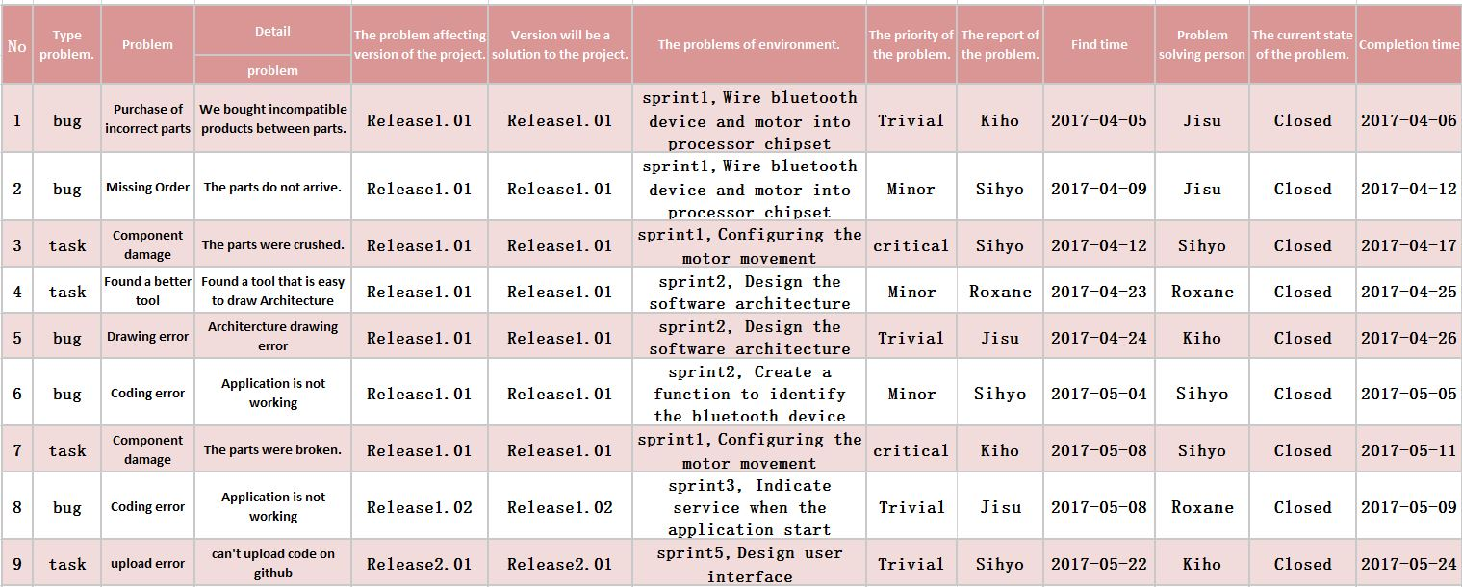
Defects Management

Slide 18
Architecture

Slide 19
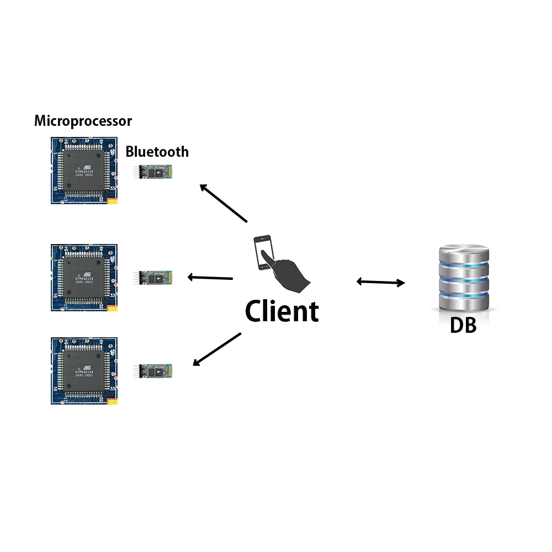
Configuration Architecture
Notes:
This is configuration architecture.

Slide 20
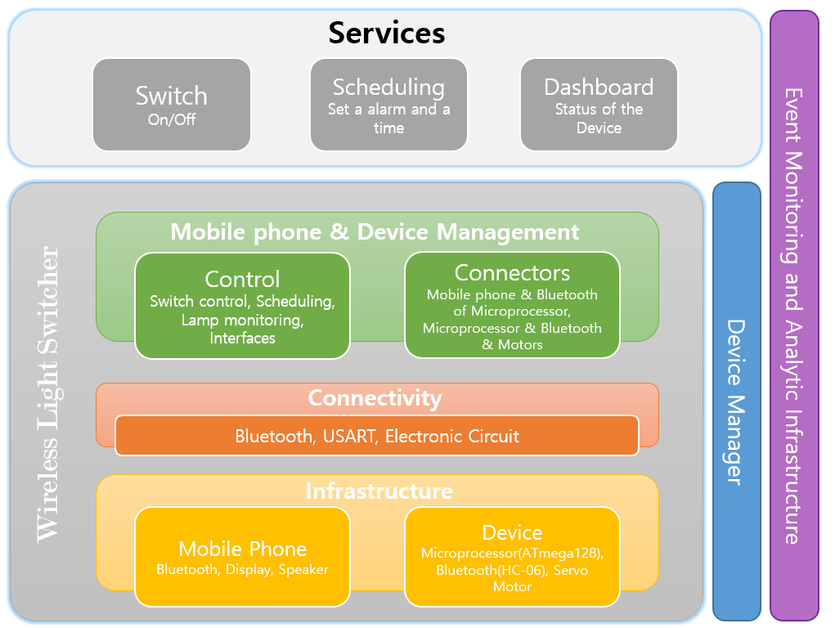
Conceptual Architecture

Slide 21
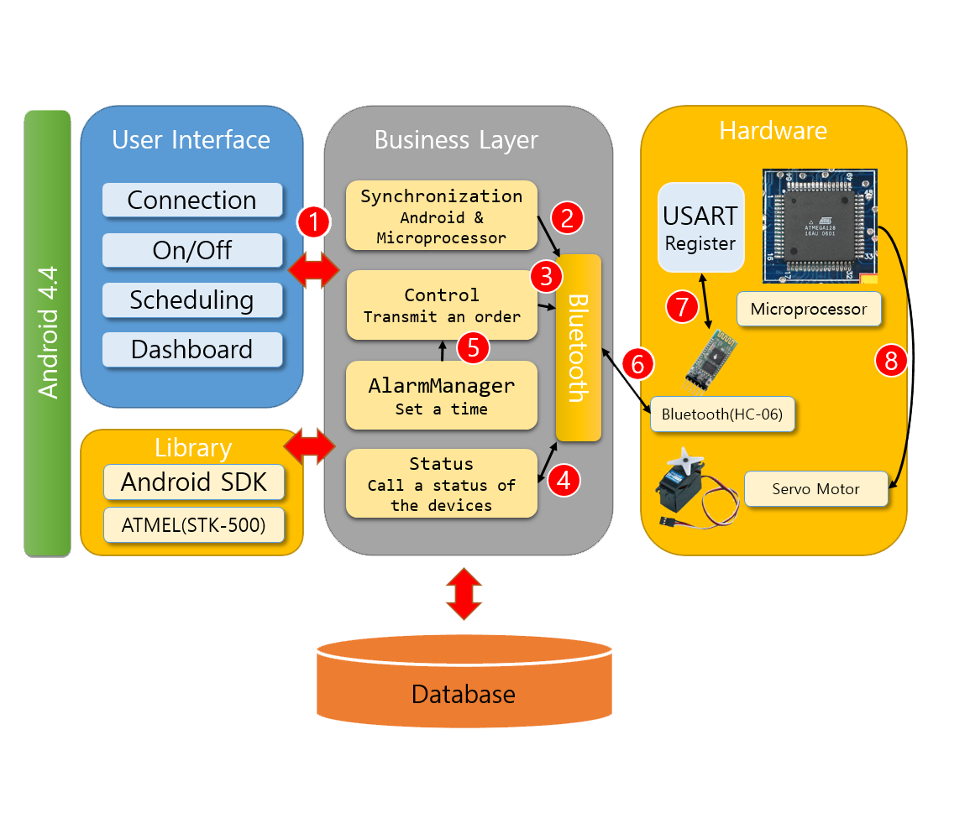
Logical Architecture

Slide 22
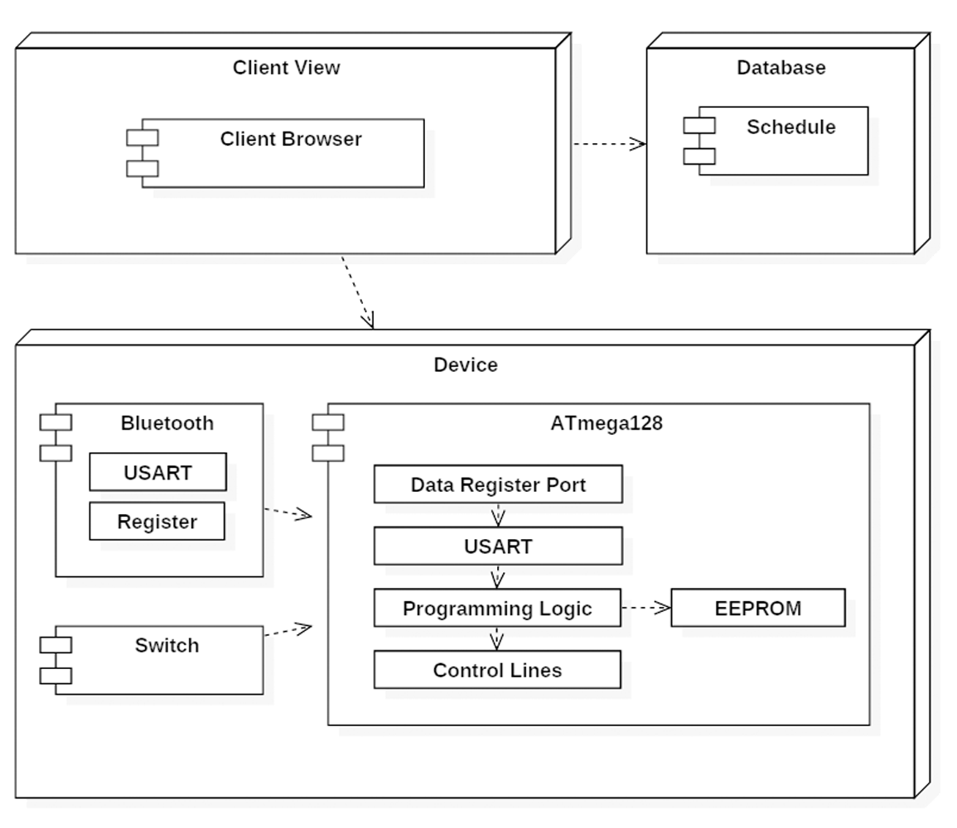
Physical architecture

Slide 23
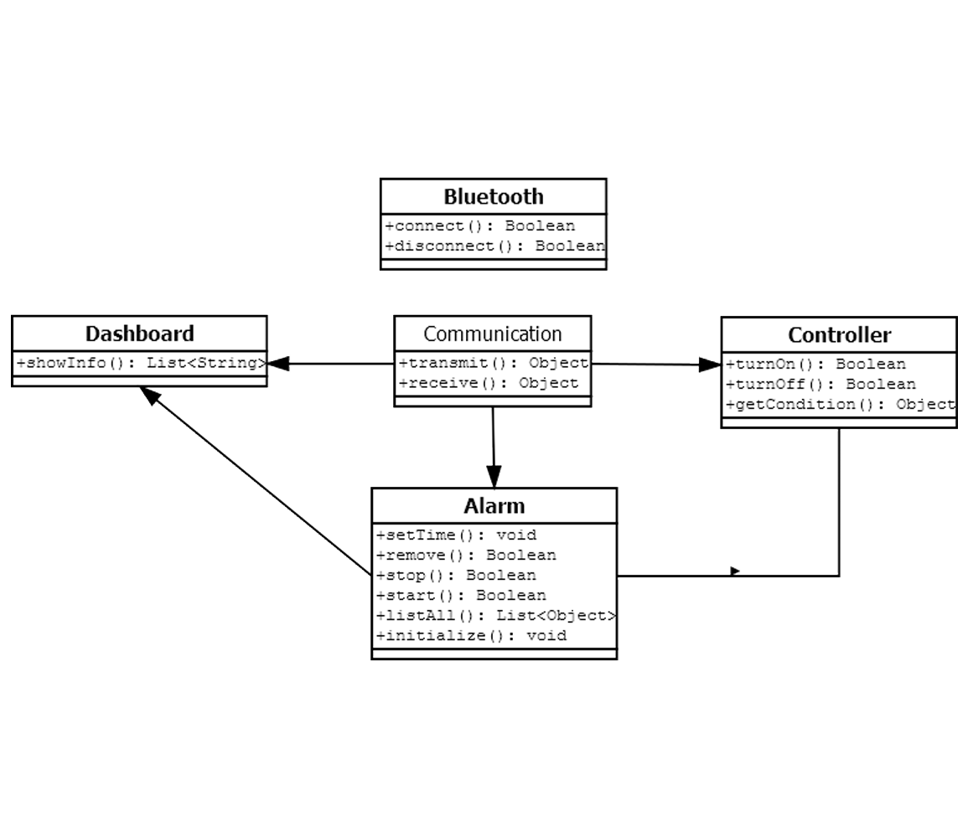
Application class Diagram

Slide 24
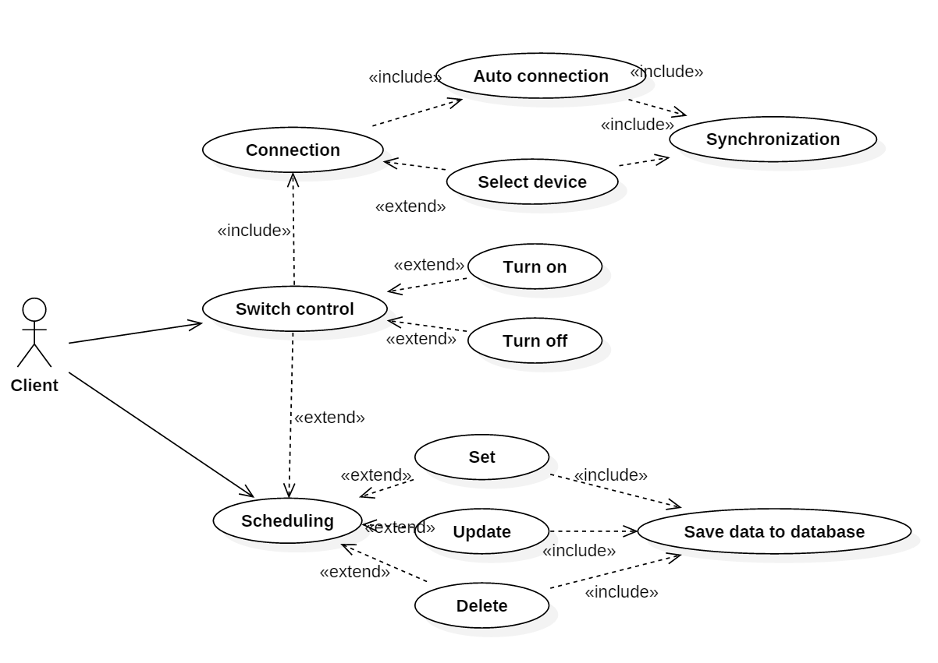
Use case

Slide 25
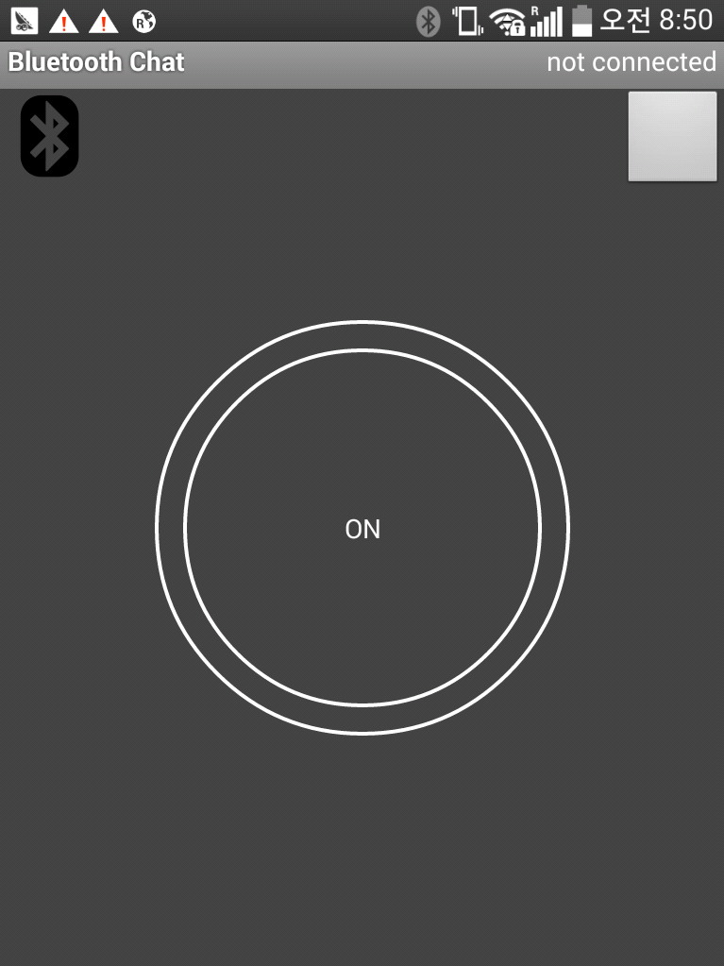
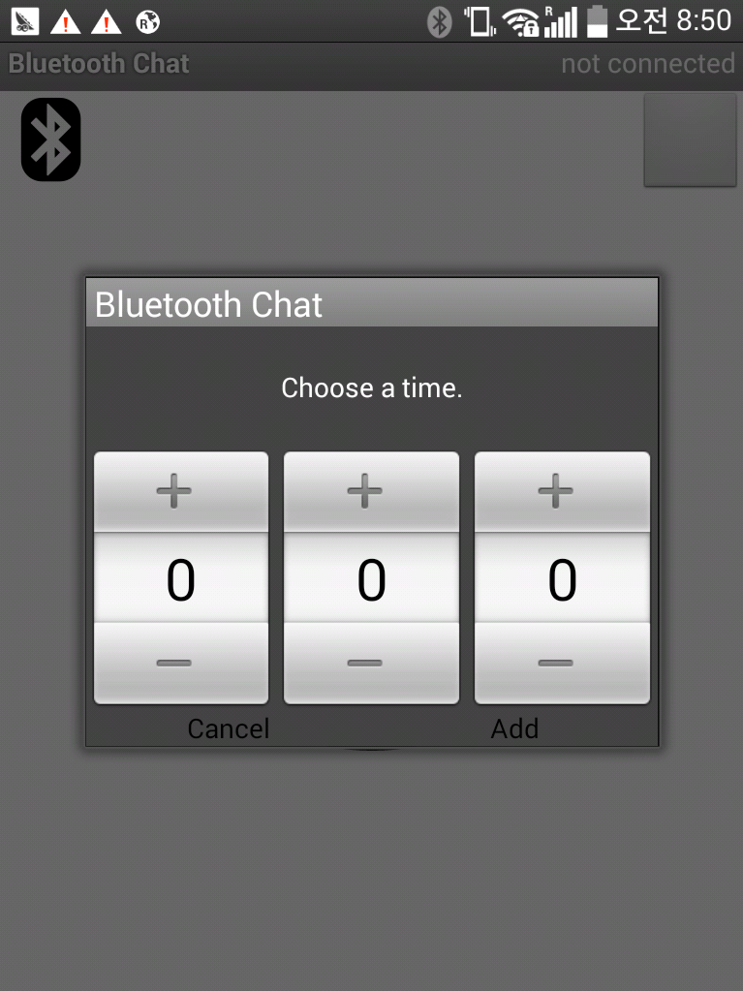
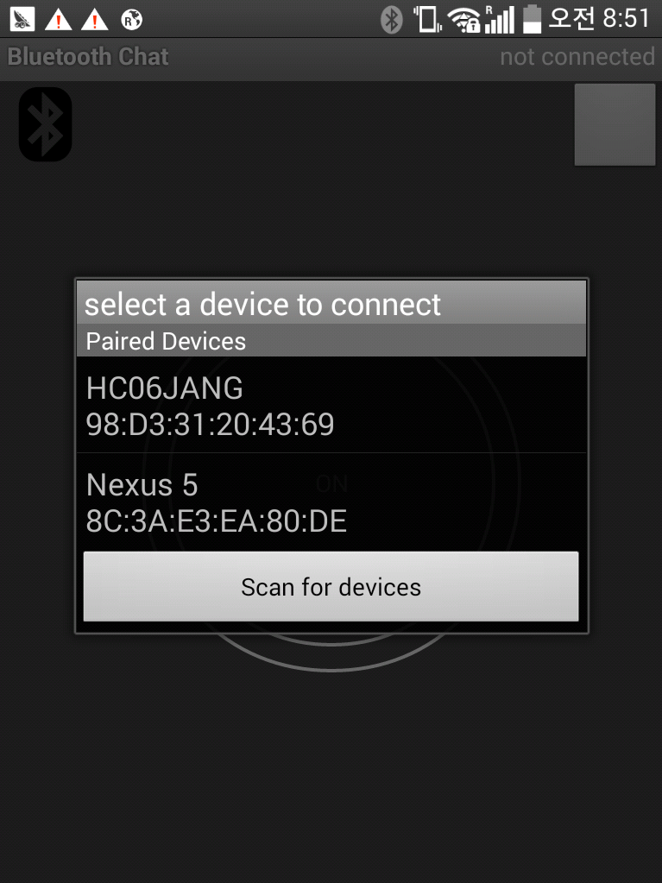
Graphic user interface
Switch
Alarm
Bluetooth

Slide 26
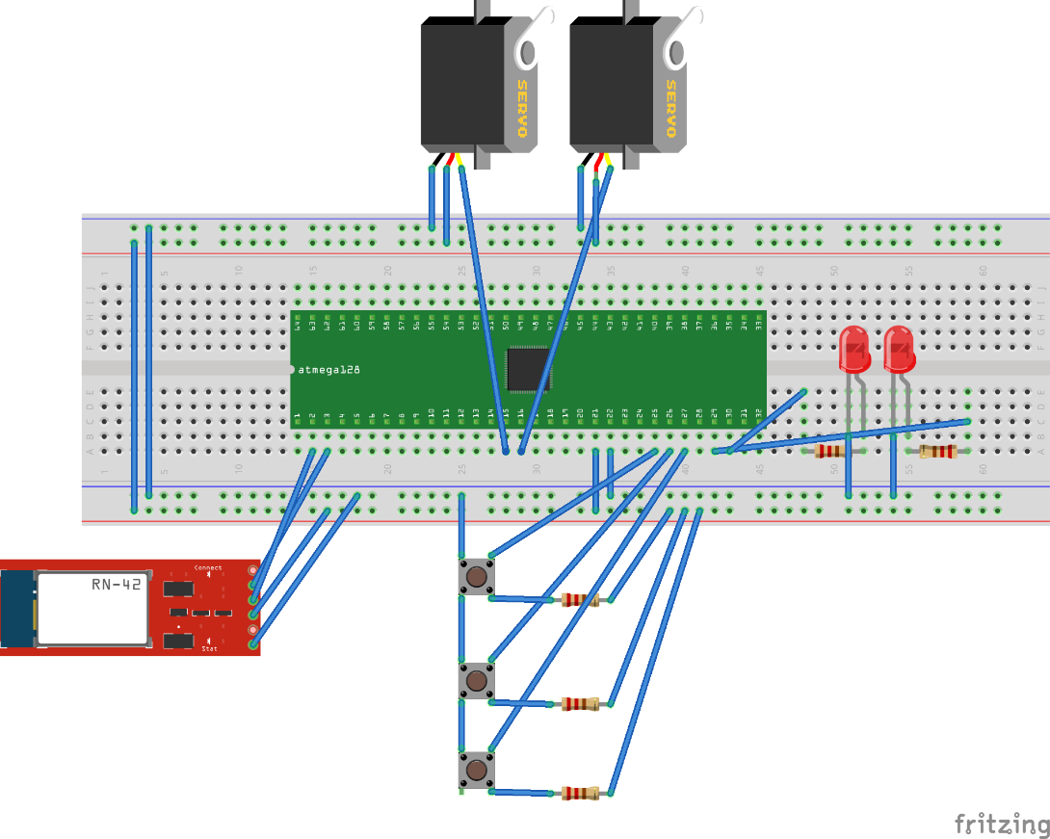
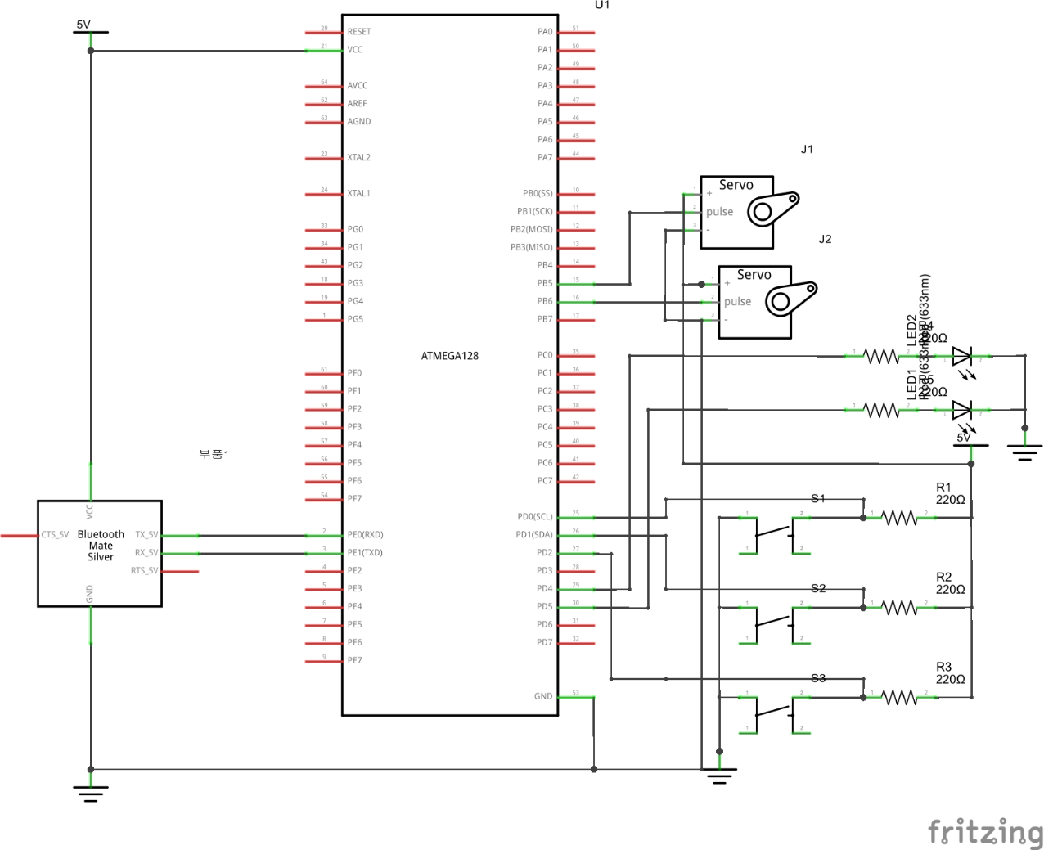
Hardware design

Slide 27

Teamwork

Slide 28
Team Contribution
Name | Contribution
Shin Kiho | Presentation, Document, Software Programming, Architecture Design
Roxane | Presentation, Document, Software Programming, Architecture Design
Park Jisu | Document, Hardware Programming, Create Hardware, UI Design
Kim Sihyo | Document, Hardware Programming, Create Hardware, UI Design

Slide 29


